Slide 1

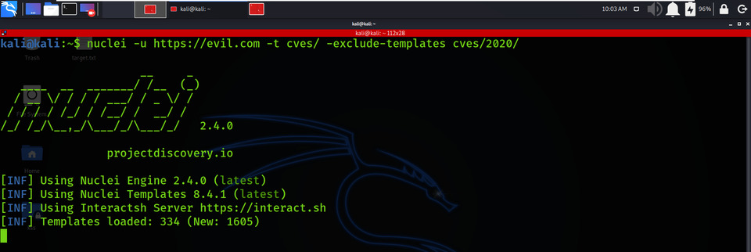

Week 10 as a Penetration Testing Intern
Solving web application based CTF
Nuclei Vulnerability Scanner
Automated tools and its use
Nuclei templates
Nuclei functionalities
Virtually Testing Foundation

